Slide 1

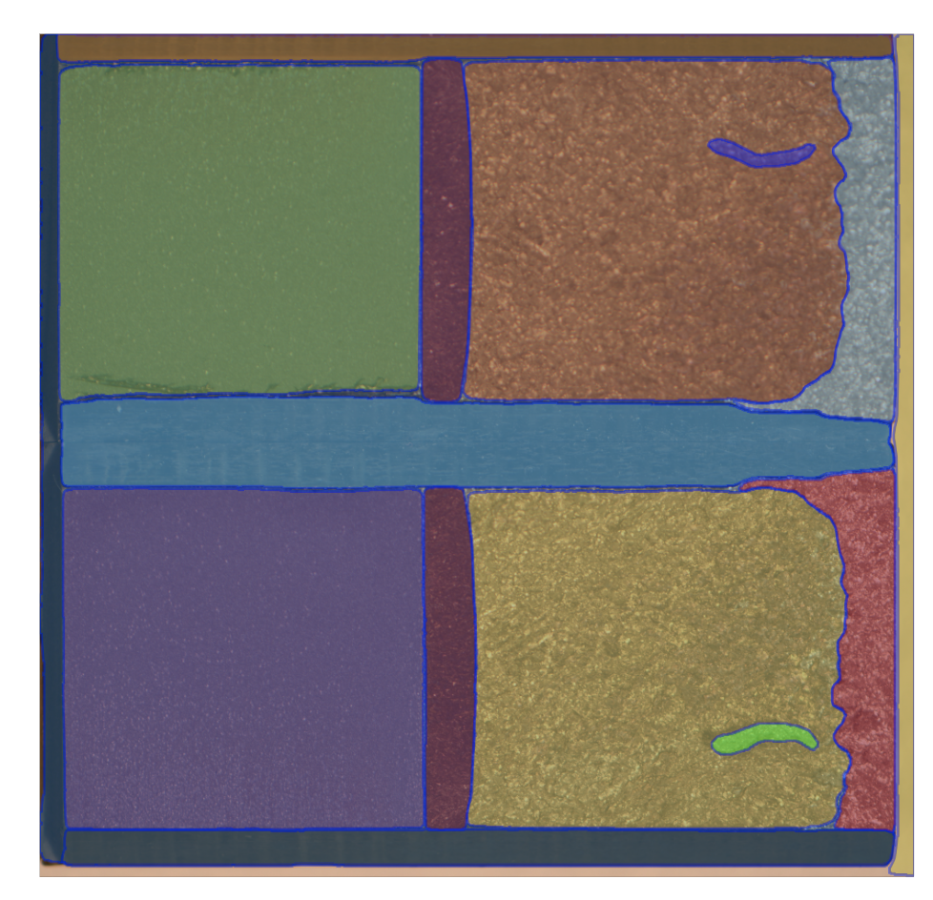
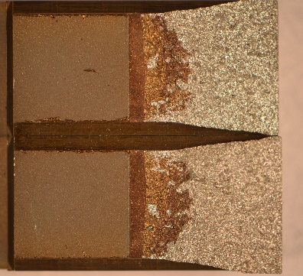
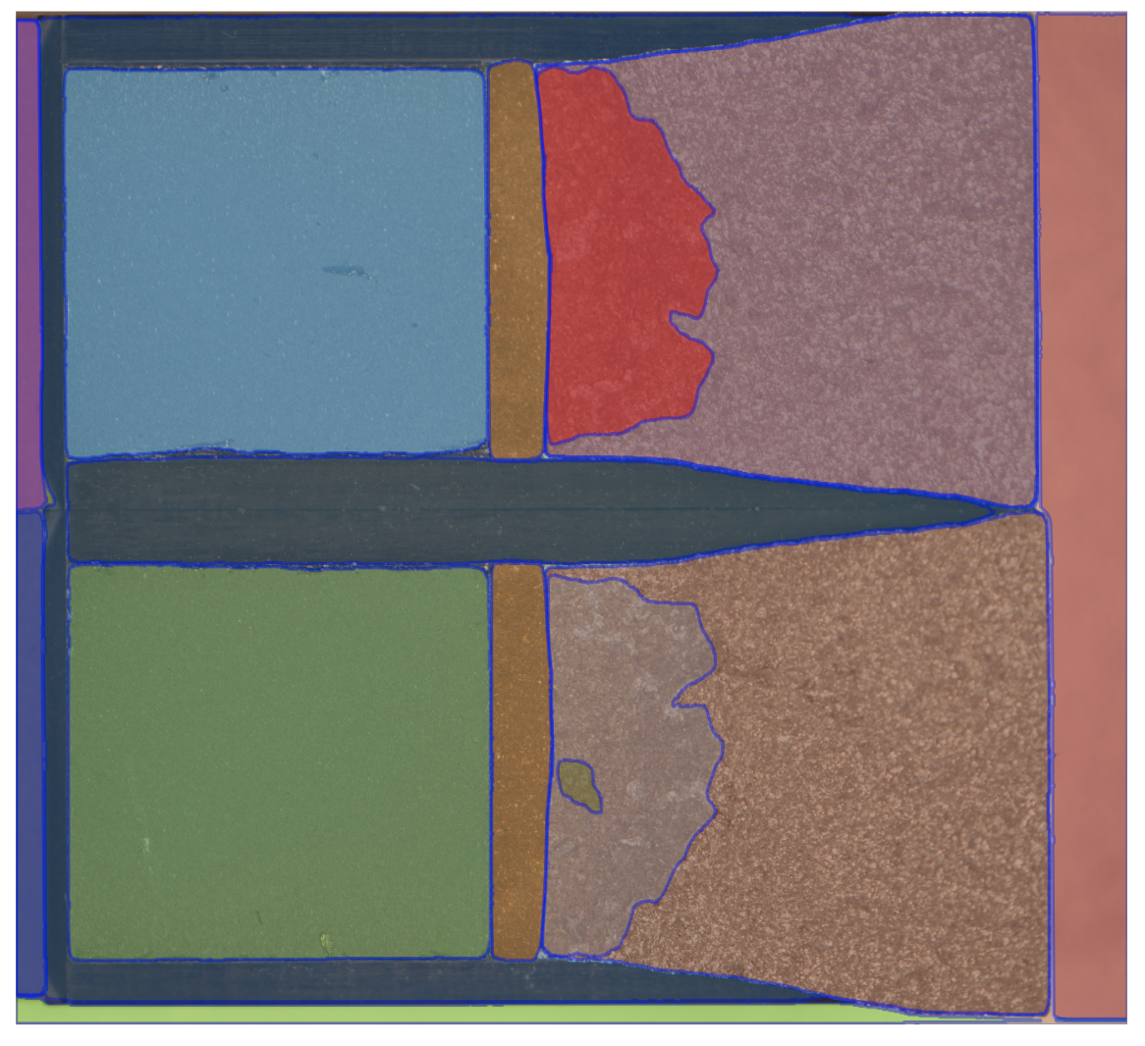
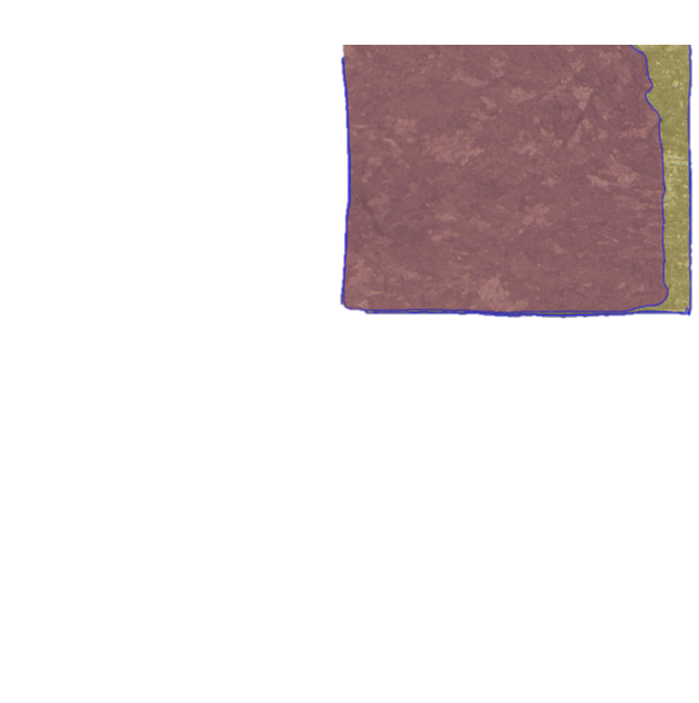
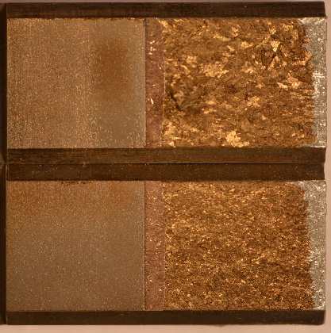
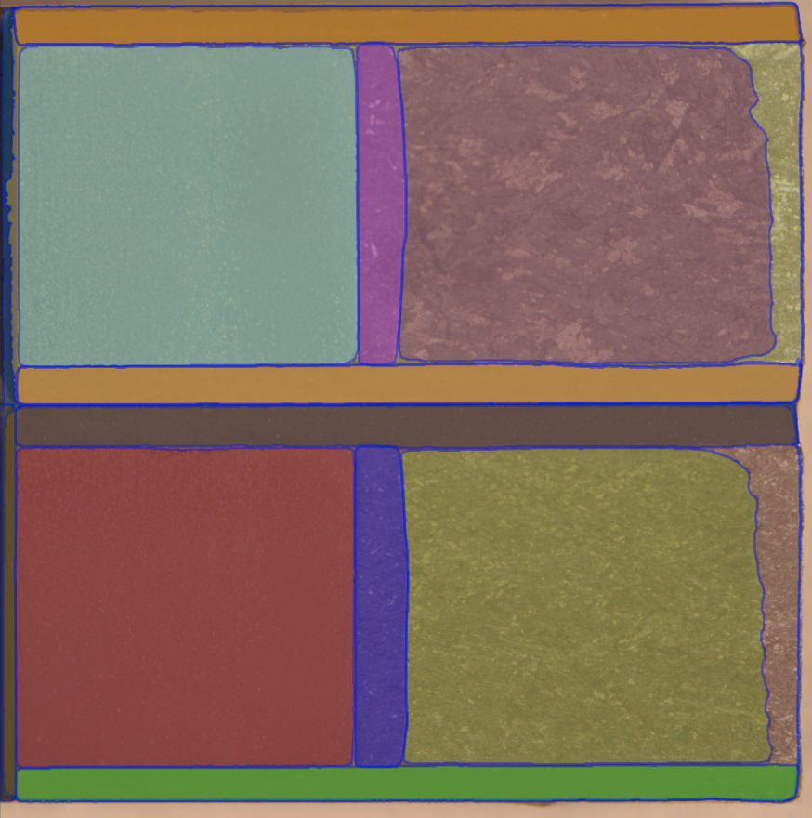
Final Model
Segment Everything Model
Error feed back
Clustering
Compare
Labels
Extracting Features: area, perimeter,…
Get the Region of Interest (ROI)

Slide 2
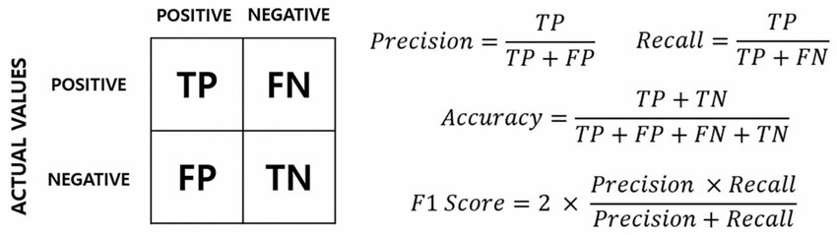
How to evaluate a model?
Provides a score that balanced the precision and recall

Slide 3
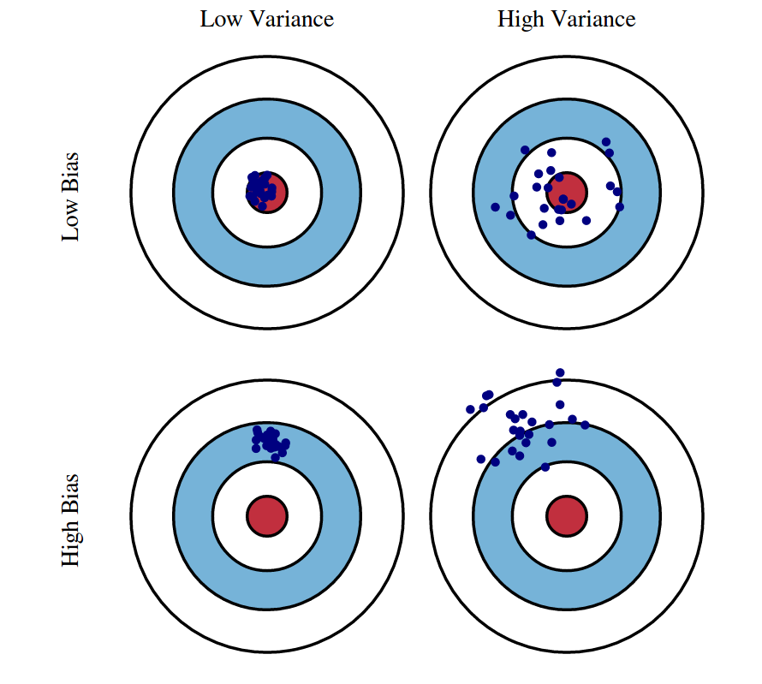
What is bias?
Bias is the difference between the average prediction of our model and the correct value which we are trying to predict. Model with high bias pays very little attention to the training data and oversimplifies the model. It always leads to high error on training and test data.
What we want
What is variance?
Variance is the variability of model prediction for a given data point or a value which tells us spread of our data. Model with high variance pays a lot of attention to training data and does not generalize on the data which it hasn’t seen before. As a result, such models perform very well on training data but has high error rates on test data.

Slide 4
We can get an F1 score by test the model on the data
Test data 1
test
test
Test data 2
model
Test data 3
…
Test data n

Slide 5
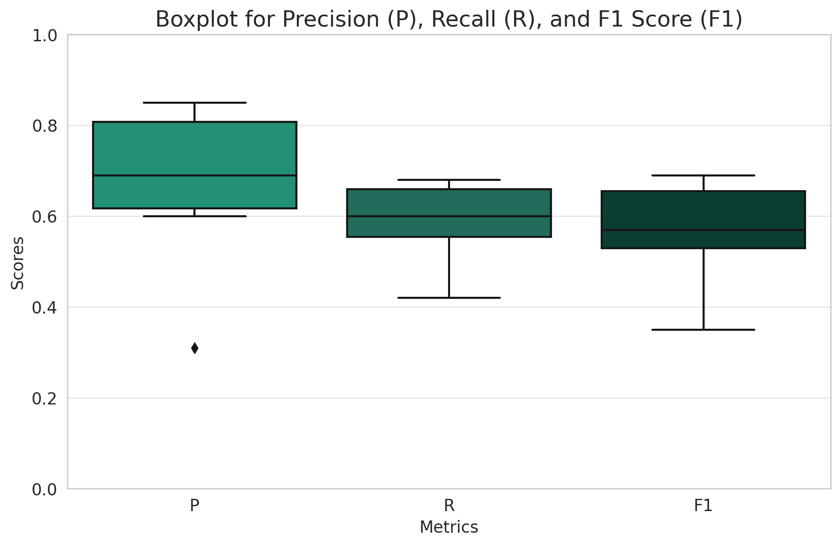
Results of our model
Bias
variance
So in our case, the bias is high(the average F1 is low), the variance is high.
<- The average value of the F1 score is approximately 0.563, and
the interquartile range (IQR), which represents the variance between the top and bottom of the box in the boxplot, is 0.125.​

Slide 6
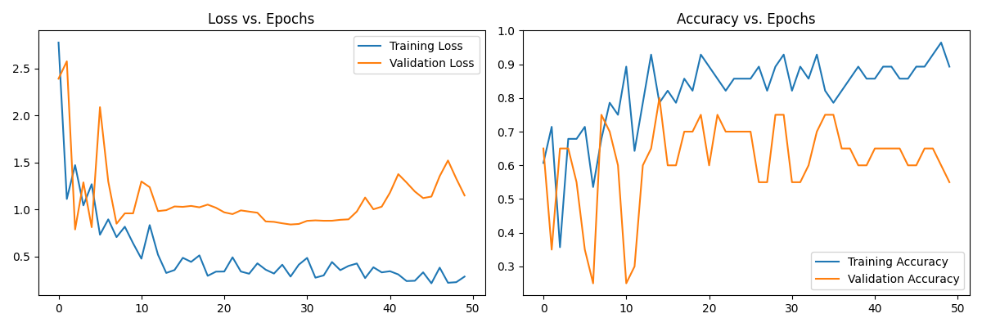
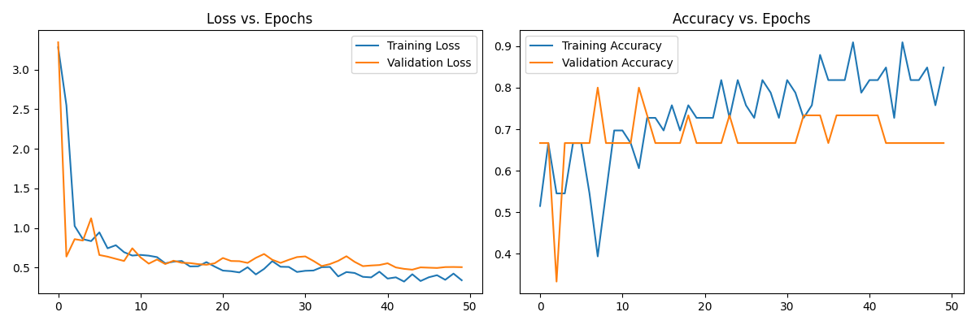
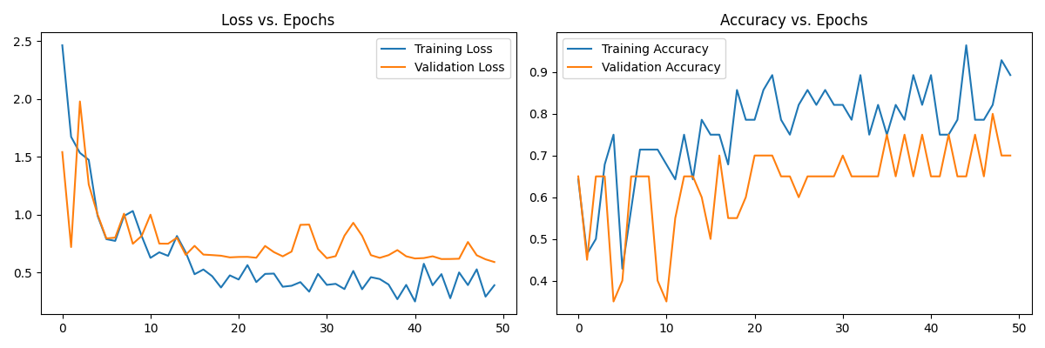
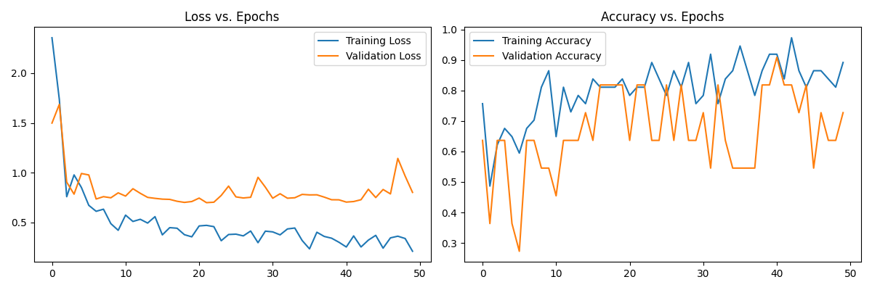
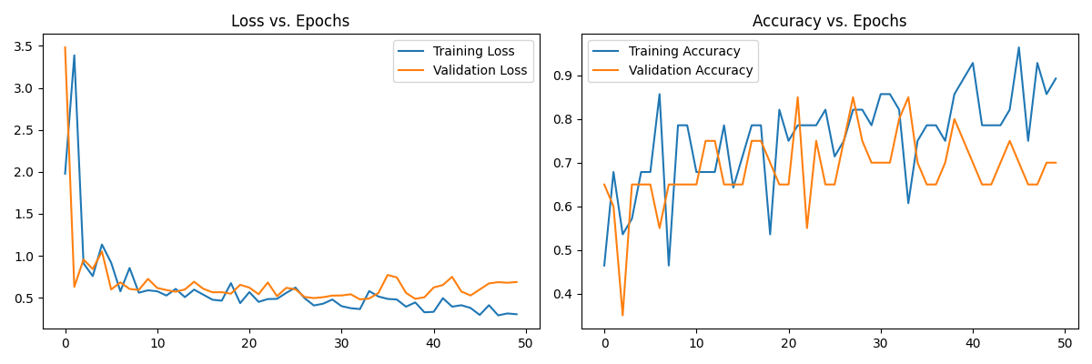
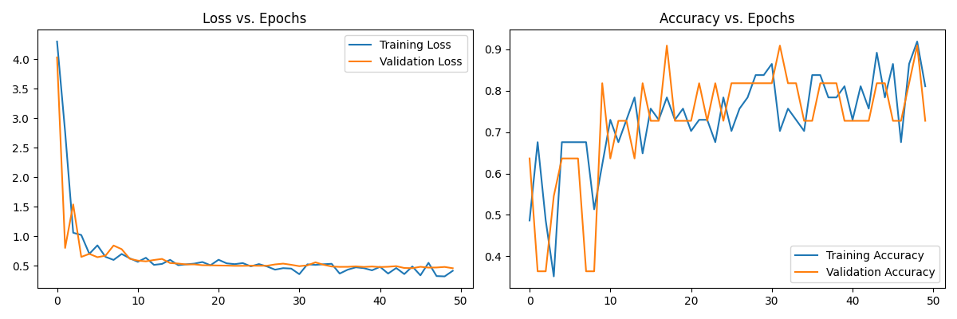
Some running results

